Slide 1
Session 1

Slide 2
Agenda
Univariate Analysis
Bivariate Analysis
Multivariate Analysis
Visualization

Slide 3
Univariate Analysis

Slide 4
Univariate analysis
Univariate analysis is the simplest form of statistical analysis
It is the study of a single (uni) variable
The key purpose is to describe the data using different numerical and
visualization techniques

Slide 5
Questions to consider before starting analysis
How many variables do you have?
Do you have missing data?
What types of variables do you have?
Every person has different questions in mind. Think from a data scientist's point
of view.

Slide 6
Read the data
Load the ‘mpg’ dataset for further analysis.

Slide 7
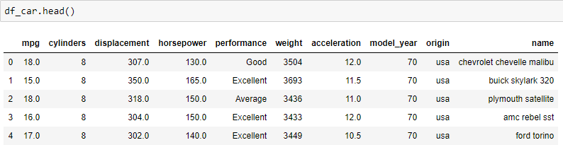
Read the data
Start by displaying the first few rows of the dataframe.

Slide 8

How many variables do you have?
We can see that the data has 398 observations and 10 variables.

Slide 9
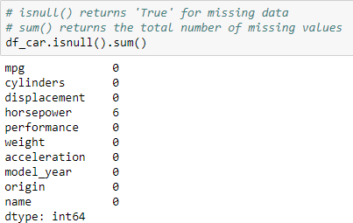
Do you have missing data?
The horsepower column contains 6 missing values.

Slide 10
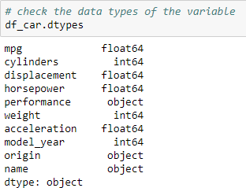
What type of variables do you have?
There are two types of variables numeric and categorical
Return the data type of each column in the dataframe
This data has 7 numeric (4 float and 3 int) and 3 categorical variables (3 object)

Slide 11
Analysis of Univariate Variable

Slide 12
Univariate analysis
Univariate
Analysis
Categorical
Variable
Numerical
Variable
Frequency Table,
Bar Plot
Summary
Statistics
Histogram, Density, Violin and Box Plot
Summary
Statistics

Slide 13
Categorical variable
In the last session, you learnt that there are three types of categorical
variable: nominal, binary and ordinal
The mpg dataset has two categorical variables, ‘origin’ and ‘performance’. The variable ‘origin’ is nominal categorical variable and ‘performance’ is an ordinal categorical variable

Slide 14
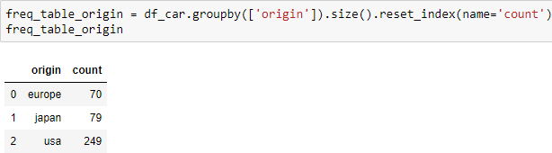
Understand the data
We count the number of unique labels of the variable ‘origin’.
Reset the index of the dataframe
Count the number of elements
Interpretation: Here, each country has a different number of
observations. The maximum number of cars are from the USA.

Slide 15
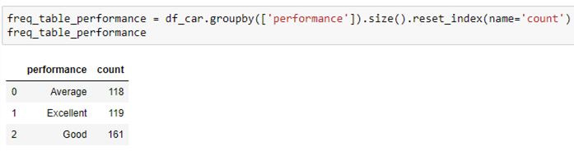
Understand the data
We count the number of unique labels of the variable ‘performance’.
Reset the index
of the dataframe
Count the number
of elements

Slide 16
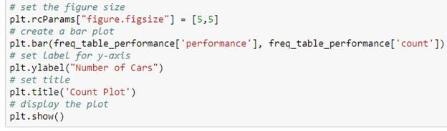
Bar plot
Use the bar plot to visualize the frequency table for the variable ‘performance’.
Changes the default settings of matplotlib. This setting will be applied to all the future plots in the same notebook session

Slide 17
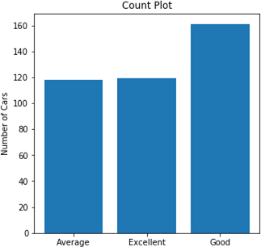
Bar plot
Interpretation: The count of cars with ‘Good’ performance is highest. Cars with ‘Average’ and ‘Excellent’ performance are nearly equal in the number.

Slide 18
What other univariate analysis can you do on the other variables?

Slide 19
Visualize numeric univariate variable
Different type of plots (such as histogram, distribution plot) can be used to check
the distribution of the univariate variable.

Slide 20
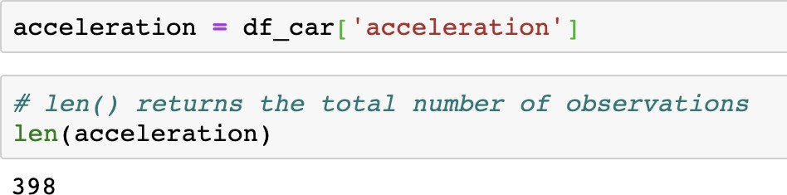
Univariate analysis
Consider the variable ‘acceleration’
Check the number of observations in the data using the len()
Interpretation: There are 398 observations in ‘acceleration’.

Slide 21
What does histogram tell us?
Histograms considers four main aspects of data viz., shape, center, spread,
and outliers
Shape can be symmetric, skewed, or have multiple peaks
Center refers to the mean or median
Spread refers to the variability of the data

Slide 22
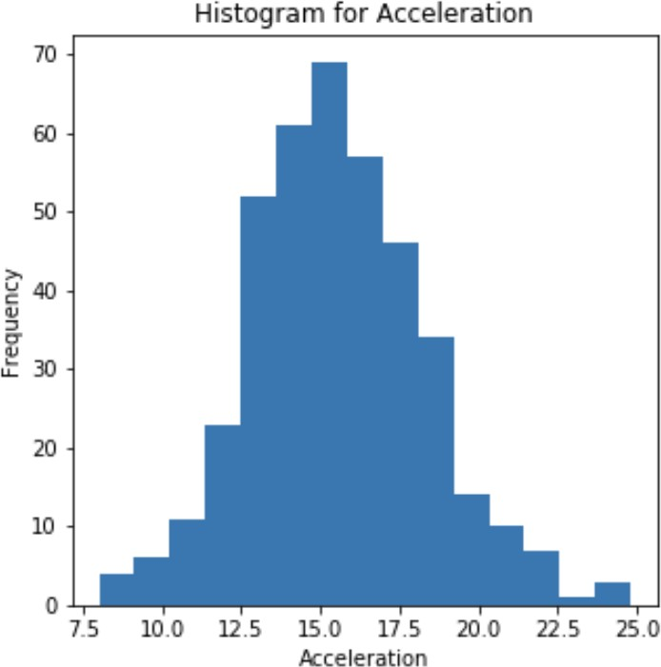
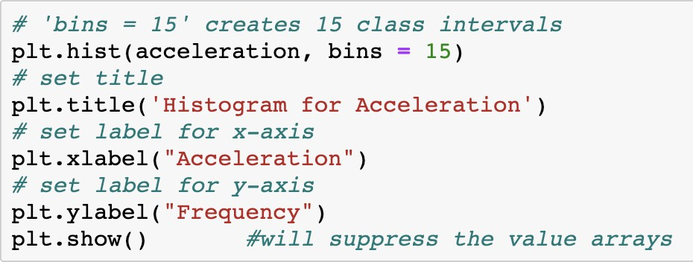
Histogram using hist()
Plot the histogram to check the frequency distribution for the variable
‘acceleration’.

Slide 23
Histogram using hist()
The histogram divides the data into bins, counts the data points in each bin
It shows the bins on the x-axis
and the counts on the y-axis
The variable ‘acceleration’
has symmetric distribution

Slide 24
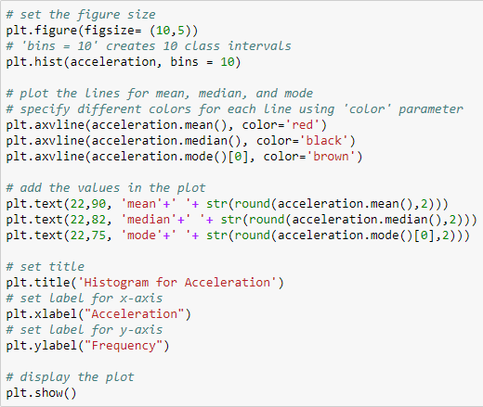
Plot a histogram with 10 bins
For a better understanding of the distribution of a variable, plot a histogram with only 10 bins. Also, plot the measures of central tendency.
Bins are also known as ‘classes’, ‘intervals’ or ‘buckets’. Bin size is chosen based on the size of the dataset.

Slide 25
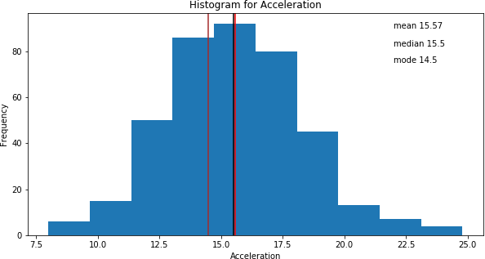
Plot a histogram with 10 bins
Interpretation: The lines for mean and median of the acceleration are close to each other with a mean value slightly higher than the median. The modal value is less than median.
It is also seen that the
distribution is near normal.

Slide 26


Optimal bin size
Sturge’s rule is one of the methods to choose the optimum bin size for a
histogram. This method is useful if the dataset is symmetric
One can consider this rule as a ‘Rule of Thumb’ rather than the formula for
optimal solution
The rule is given as:
Where,
K = Number of bins
N = Number of observations in the dataset

Slide 27
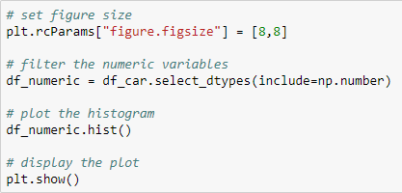
Plot a histogram for all numeric variables
We can plot histograms for all the numeric variables in a single plot.

Slide 28
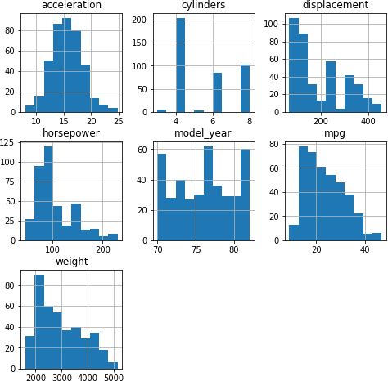
Plot a histogram for all numeric variables
Interpretation: The variables ‘displacement’, ‘horsepower’, ‘mpg’, and ‘weight’ are positively skewed.

Slide 29
What is density plot?
A density plot is a smoothed version of histogram estimated from the data
The ‘kde’ (Kernel Density Estimator) is drawn at every individual data point and all of these curves are then added together to create a single smooth density estimation

Slide 30
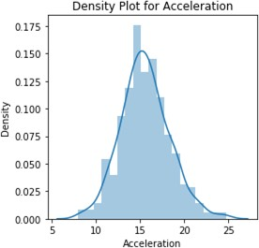
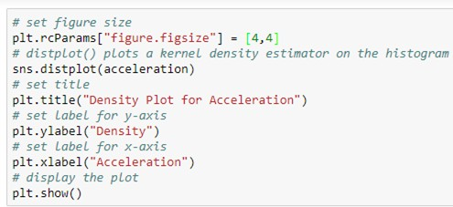
Distribution plot using distplot()
Interpretation: The distribution of the acceleration is near normal.

Slide 31
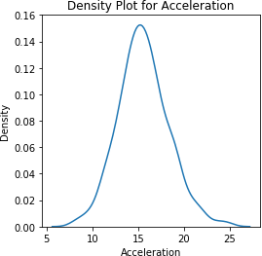
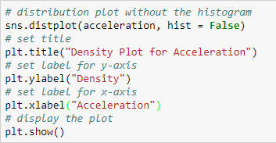
Distribution plot using distplot()
We can also plot a distribution plot without the histogram.
Whether to plot
histogram or not

Slide 32
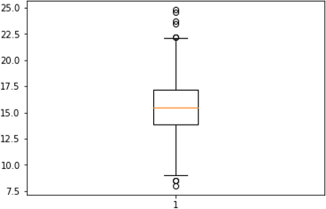

Box plot
Let us plot the box plot of ‘acceleration’ to see the distribution.
Outliers
Outliers
Interpretation: Points above and below the whiskers are outliers
in the variable. These outliers can affect the model performance.

Slide 33
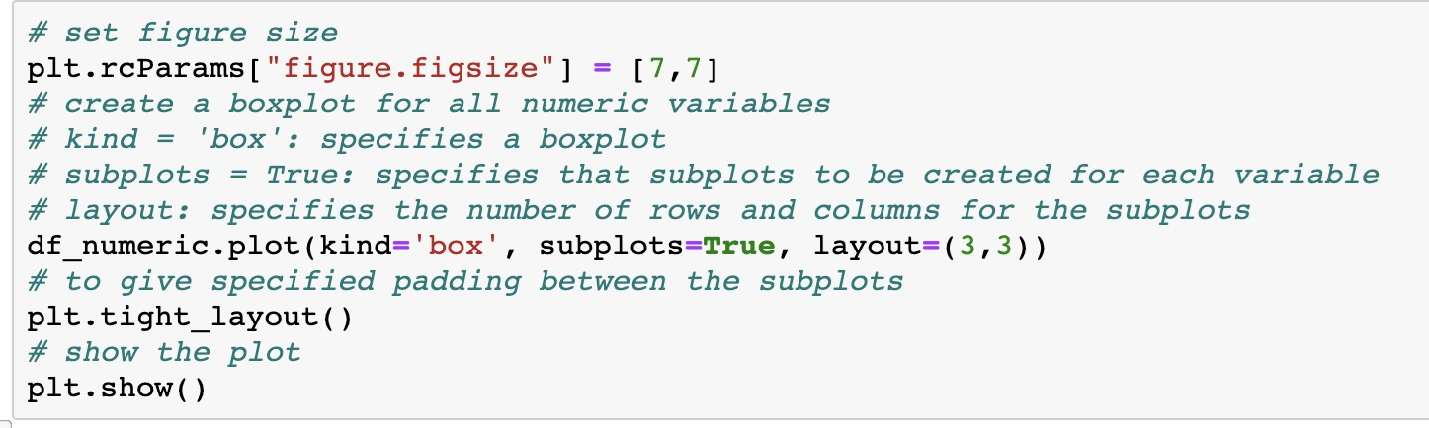
Create a box plot for all numeric variables

Slide 34
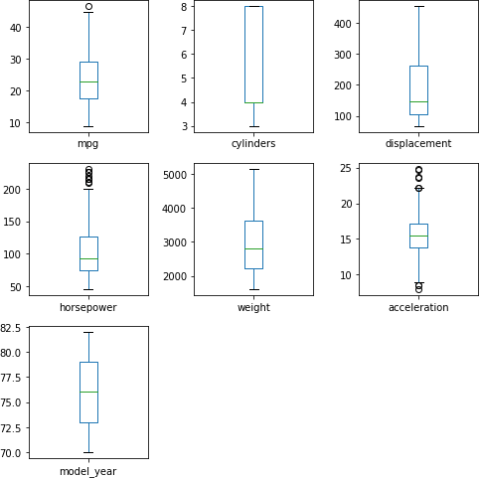
Create a box plot for all numeric variables
Interpretation: The outliers are present in the variables ‘mpg’, ‘horsepower’, and ‘acceleration’.

Slide 35
What is violin plot?
The violin plot is a combination of box plot and histogram
It gives the statistical distribution such as mean, median, mode
Violin plot shows the distribution of the data and potential outliers

Slide 36
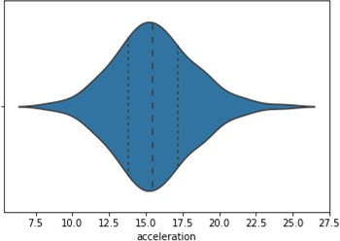
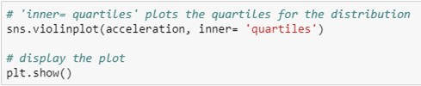
Distribution plot using violinplot()
1st Quartile
3rd Quartile
Interpretation: The distribution of the ‘acceleration’ is symmetric.

Slide 37
Cumulative distribution
Cumulative Distribution Function (CDF) determines the cumulative probability value. It calculates the probability that a random observation (X) taken from the population is less than or equal to a certain value (x).

Slide 38
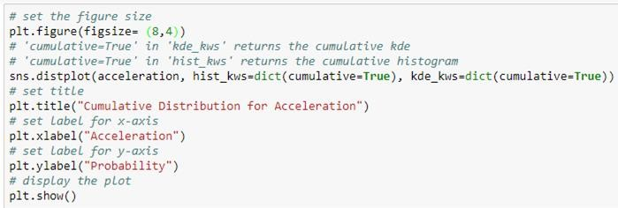
Cumulative distribution
Plot the cumulative distribution of the variable ‘acceleration’.

Slide 39
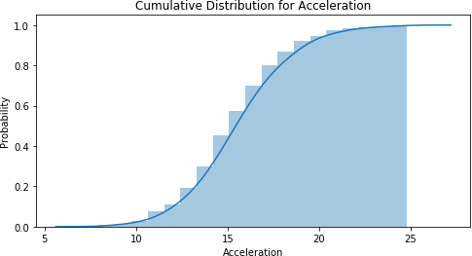
Cumulative distribution
Interpretation: Here you get the cumulative probability for the different acceleration. There are very few cars which has acceleration more than 22 because the curve becomes constant.

Slide 40
Plot and interpret the cumulative distribution plot for other numeric variables.

Slide 41
Multivariate Analysis

Slide 42
Multivariate analysis
It is the analysis of two or more variables
Used to study the relationships between the variables
Useful in determining the effect of one variable on other variables

Slide 43
Multivariate analysis
Multivariate Analysis
Categorical -
Categorical
Numerical -
Categorical
Numerical -
Numerical
Multiple/ Stacked Bar Plot
Cross
Tabulation
Box Plot
Scatter Plot
Heatmap

Slide 44
Scatter plot
A scatter plot is used to plot the two numeric variables on X and Y axis
It can be used to study the correlation between two numeric variables
One can also detect the extreme observations using a scatter plot

Slide 45
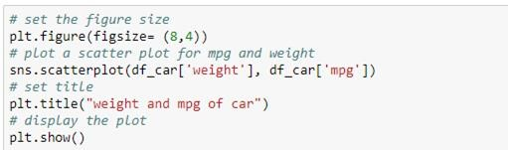
Scatter plot
Let us study the relationship between the variables ‘mpg’ and ‘weight’ using a
scatter plot.

Slide 46
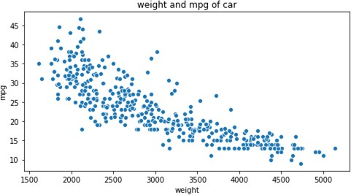
Scatter plot
Interpretation: The scatter plot shows that the variables ‘mpg’ and ‘weight’, are negatively correlated with each other. i.e. as the weight of car increases, the corresponding value for mpg decreases.

Slide 47
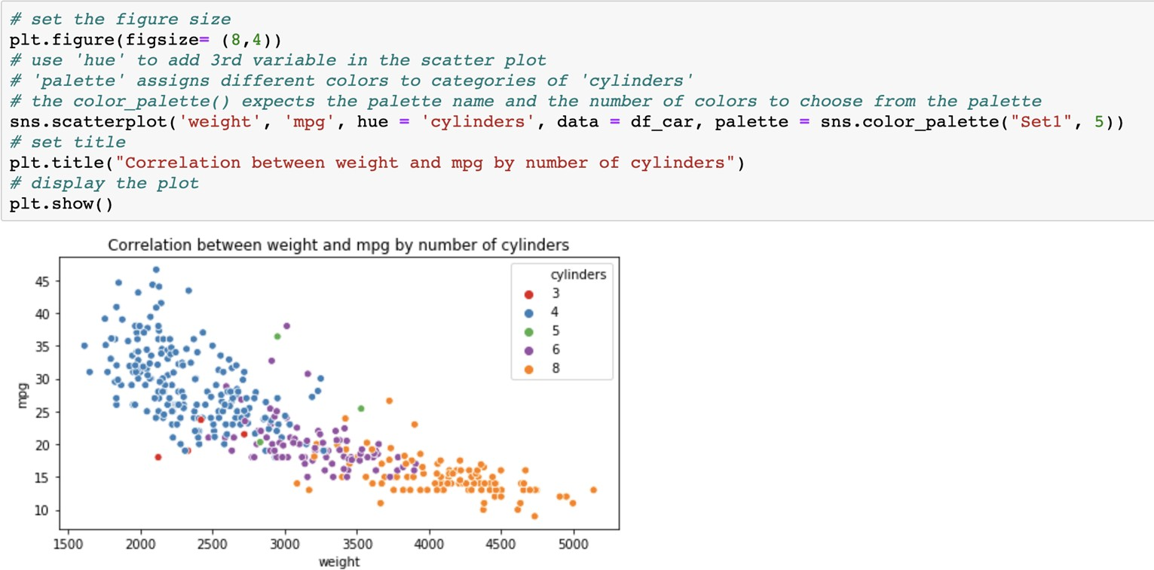
Scatter plot with hue parameter
Interpretation: With increase in weight the mpg decreases as the number of cylinders
increases.

Slide 48
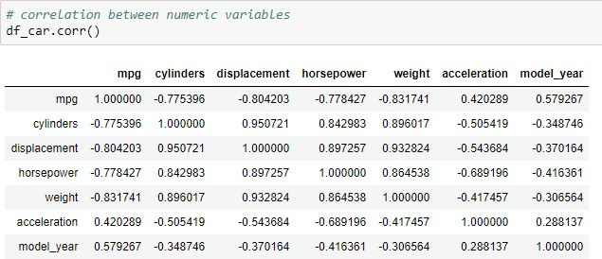
Correlation matrix
Interpretation: Diagonal values will always be 1, as it represent the correlation of a variable with itself (perfect correlation).
The highest positive correlation is between displacement and cylinders.
We also notice a few strong negative and strong positive correlations.

Slide 49
Correlation matrix
You know that if you have a data set with many columns, a good way to quickly check correlations between variables is by visualizing the correlation matrix as a heatmap. Let’s start by plotting a heatmap for the data set.

Slide 50
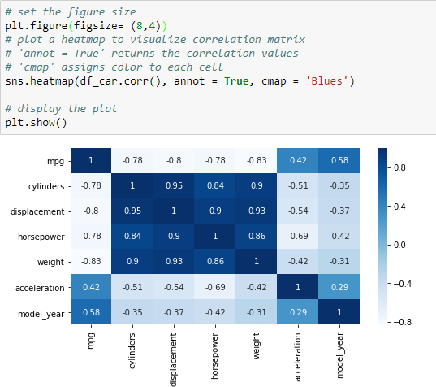
Heatmap to visualize correlation matrix
Interpretation: The heatmap represents the correlation matrix. Here, the color of each cell depends on the correlation
values. The
darker
the
color
higher
represents correlations.

Slide 51
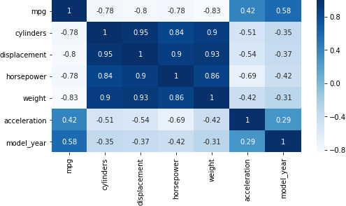
Heatmap to visualize correlation matrix
We can see the positive
correlation between weight, horsepower, displacement and cylinders.

Slide 52
Pair plot
The pairplot() exhibits the relationship between all numerical variables
The plots on the diagonal display the distribution of each numeric variable and the off-diagonal plots are the scatter plots explaining the relationship between two pair of variables

Slide 53
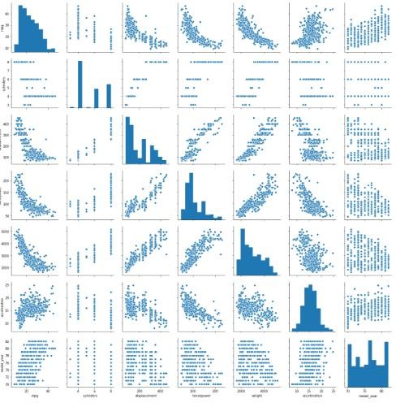

Pair plot

Slide 54
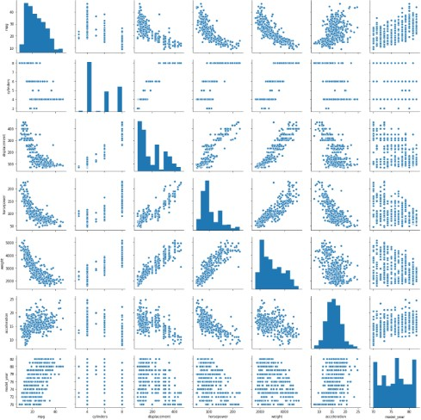
Pair plot

Slide 55
What are the other variables that have the strong and weak relationship?

Slide 56
Grouped box plot
Grouped box plots can be used to visualize the distribution of a numeric variable by groups
of a categorical variable

Slide 57
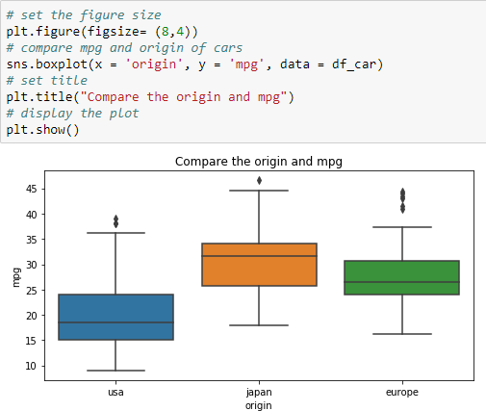
Grouped box plot
Interpretation: There is significant
difference in mpg for all three
countries.
Japanese origin cars
have highest mileage. We can observe that all the three box plots have extreme values (above the upper whisker).

Slide 58
Types of Bivariate Analysis

Slide 59
Types of bivariate analysis
Bivariate
Analysis
Quantitative - Quantitative
Quantitative - Categorical
Categorical - Categorical

Slide 60
Quantitative and Quantitative

Slide 61
Quantitative and quantitative
Quantitative and quantitative analysis represents the relationship between
two numeric variables
Following graphs can be used for quantitative data:
Line plot
Scatter plot
Heatmap

Slide 62
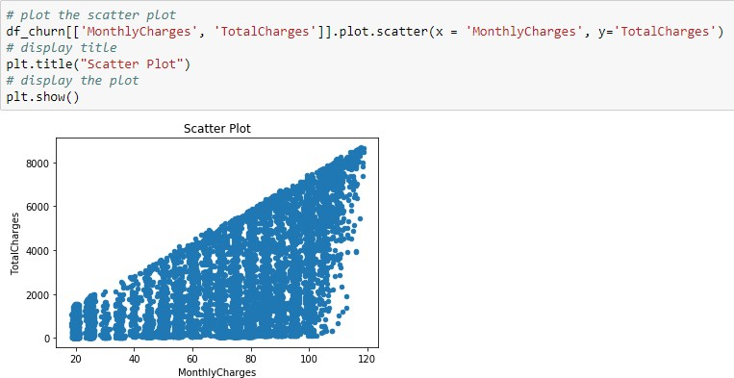
Quantitative and quantitative
Now let’s take a look at relationship between monthly and total charges.

Slide 63
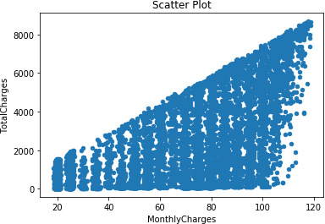
Quantitative and quantitative
Interpretation: We observe that the total charges increase as the monthly
charges for customer service increases.

Slide 64
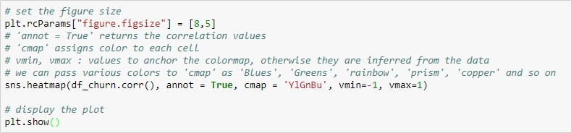
Correlation between numeric features
We will see the correlation between customer’s tenure, monthly charges, and
total charges.

Slide 65
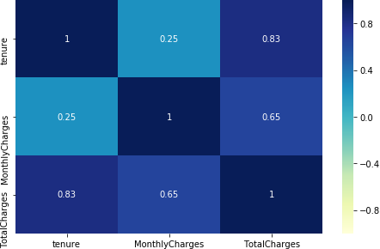
Correlation between numeric features
Interpretation:
Strong
exists
positive correlation
between tenure and
total
the
charges, which means
total charges increase as the duration of the customer with the company increases.

Slide 66
What are the other relationships
between the numeric variables?

Slide 67
Quantitative and Categorical

Slide 68
Quantitative and categorical
Quantitative and categorical analysis represents the relationship between
one numeric and one categorical variable
Following graphs can be used for quantitative and categorical data:
Bar chart
Kernel density plot
Box plot
Violin plot

Slide 69
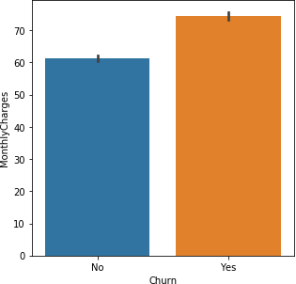
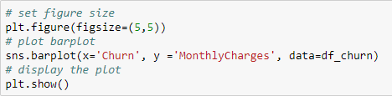
Bar chart
Let’s take a look at the target variable (churn rate) and understand its interaction
with other variables.

Slide 70
Bar chart
Interpretation:
It is
clear that, a
customer paying
higher charge is
the
prone to churn. However,
difference between the monthly charges of churned and not churned customers is not much.

Slide 71
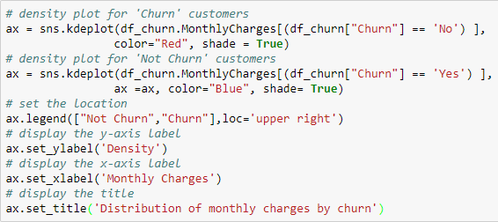
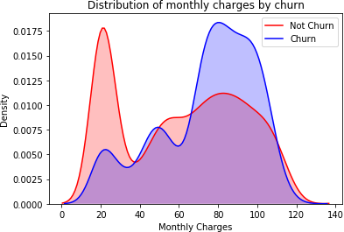
Kernel density plot
Let us understand the relation between ‘MonthlyCharges’ and ‘Churn’.

Slide 72
Kernel density plot
Interpretation: It shows that large number of customers churn when the monthly charges are high.

Slide 73
Box plot
Boxplots are a standardized way of displaying the distribution of data based on a five number summary - minimum, first quartile (Q1), median, third quartile (Q3), and maximum.

Slide 74
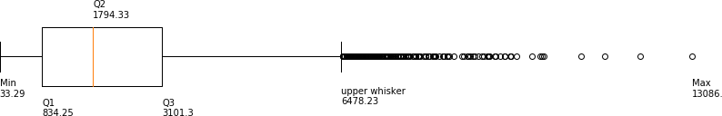
Box plot
The whiskers give an idea about the spread of the data
The dots outsides of the whiskers show outlier values

Slide 75
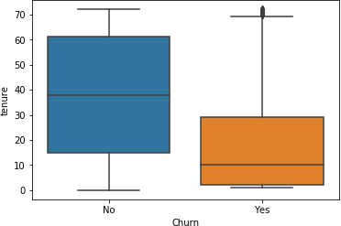

Box plot
Create a box plot for ‘tenure’ by ‘churn’ to see the distribution.

Slide 76
Box plot
Interpretation: As we can see from the plot, the customers who do not churn, tend to stay for a longer tenure with the telecom company.

Slide 77
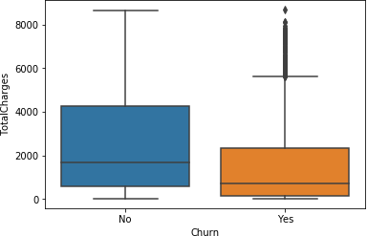

Box plot
Create a box plot for ‘TotalCharges’ by ‘churn’ to see the distribution.

Slide 78
Box plot
Interpretation: From this plot, we can infer that the average total charges for both the customers are nearly the same.

Slide 79
What other information can you find from the different box plots?

Slide 80
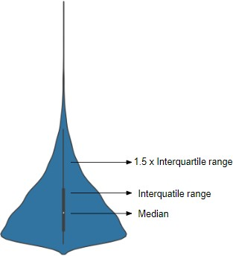
Violin plot
Violin plot represents the same
summary statistics as box plots
The white dot represents the median
The thick gray bar in the center is
the interquartile range

Slide 81
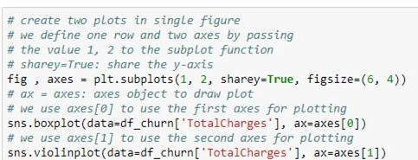
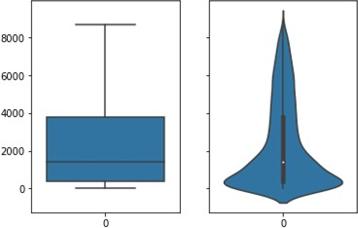
Box plot and violin plot
Create a box plot and violin plot for the variable ‘TotalCharges’ to see the
similarity.
Comparison between box plot and violin plot

Slide 82
Box plot and violin plot
Interpretation: In the box plot, the median is towards the 1st quartile and upper whisker is long, which tells that it is positively skewed. However, In the violin plot, the bulge is towards the bottom of the plot.
Comparison between box plot and violin plot

Slide 83
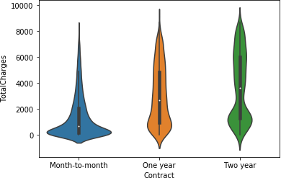
Violin plot
Create a violin plot for ‘TotalCharges’ by ‘Contract’ to see the distribution.

Slide 84
Violin plot
Interpretation: The average total charges for all contracts is between 0 to 4000. The customers in ‘Month-to- Month’ contract have a positively skewed distribution. The median value of total charges increases with the increase in duration of the contract.

Slide 85
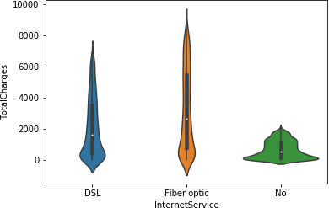
Violin plot
Create a violin plot for ‘TotalCharges’ by ‘InternetService’ to see the distribution.

Slide 86
Violin plot
Interpretation: The total charges of the customers who are not using internet service are very less. The average (median) total charges for the ‘DSL’ and ‘Fiber optic’ are nearly the same.

Slide 87
Categorical and Categorical

Slide 88
Categorical and categorical
We will use a cross tab and stacked bar chart to visualize the relationship between two categorical variables
Consider the categorical variables in the dataset to create a stacked column
chart

Slide 89

Crosstab
Following are the counts of churned customers using different services.
Values to group by in the
rows
Column to aggregate

Slide 90

Crosstab
Interpretation: The rows represent the category of ‘Churn’, and the columns represent the categories of ‘InternetService’. The highest number of customers who did not churn used ‘DSL’ service while people who used ‘Fiber optic’ churned the most.

Slide 91

Stacked bar chart
Check the distribution for churn by the levels of the variables ‘Contract’.
Values to group by in the rows
Values to group by in the
columns
To get the count
Column to aggregate

Slide 92

Stacked bar chart
Interpretation: The customer who signed a longer duration contract has a lower churn rate.

Slide 93

Stacked bar chart
Check the distribution for churn by the levels of the variables ‘PaperlessBilling’.
Values to group by in the
rows
Values to group by
in the columns
Column to aggregate
To get the count

Slide 94

Stacked bar chart
Interpretation: The customers who choose paperless billing have a higher churn rate than other billing methods.

Slide 95
Use a stacked bar plot to see the relation between the ‘Churn’ and ‘PaymentMethod’.

